Slide 1


HoloLens: Augmented Reality using OOP Concepts
Team Member(s): Paola Jiron and Andres Chalela Product Owner(s): Francisco Ortega
Instructor: Masoud Sadjadi
Mentor: Francisco Ortega, Mohsen Taheri
School of Computing and Information Sciences Florida International University
Final Presentation
2017
Notes:
7 seconds.( I will select 2 best slides (i will give them extra points and students will present for CIS committee)
Greet your audience, thank them for attending your presentation, introduce yourself, introduce your project, introduce your team members, and quickly indicate what each of you did in a high-level manner, and put more emphasis on your part/contribution.

Slide 2
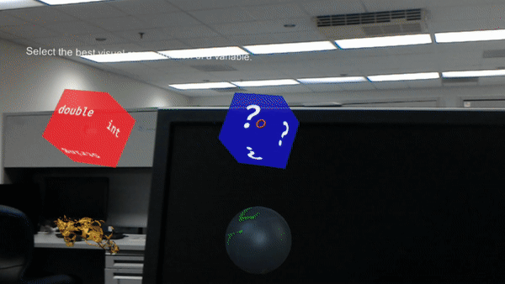
What is Augmented Reality?
Interactive Learning
Notes:
10 seconds.
Introduce the problem that the whole project (in all versions) tackles with GIF or screenshot.

Slide 3
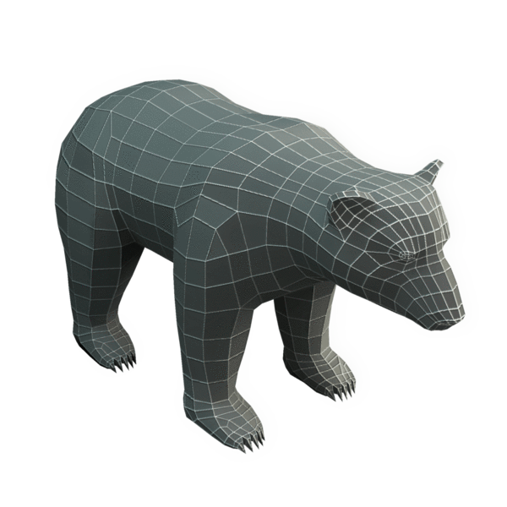
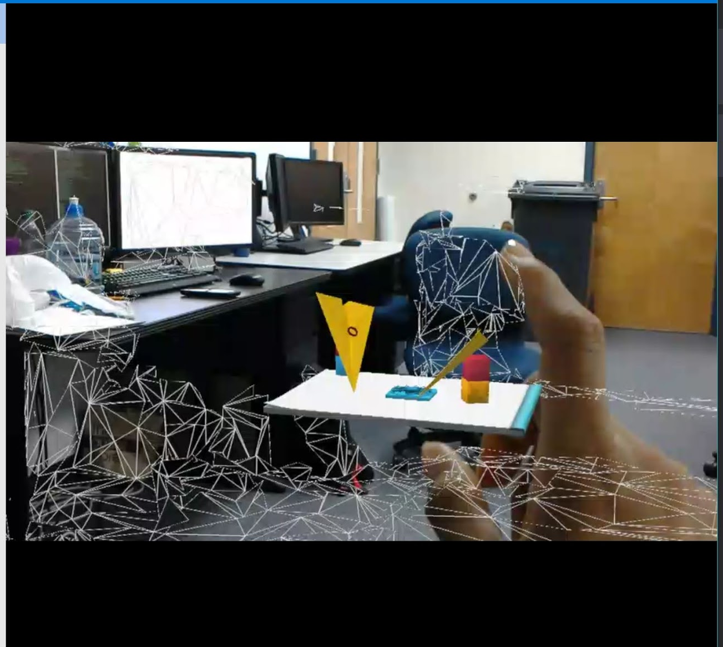
What is Augmented Reality?
Live view of a physical, and real-world environment
Supplemented elements
Computer-generated inputs:
Sound
Video
Graphic or Global Positioning System (GPS) data.
Bear Mesh
Mesh Environment

Slide 4
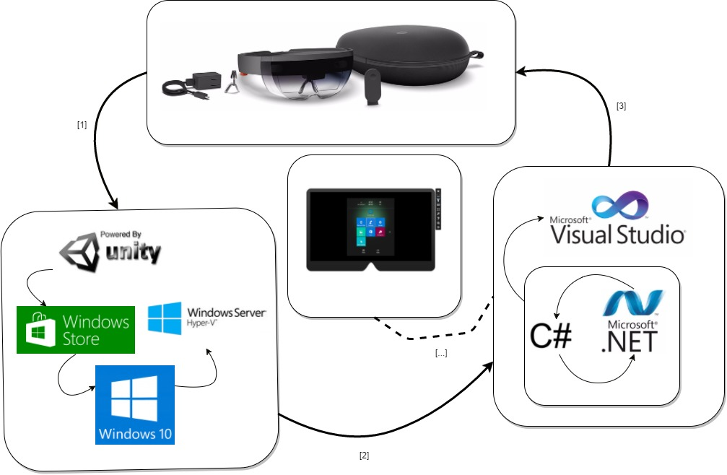
Development Process
Development Cycle
Notes:
20 seconds.
Introduce the problem that the your project (in new version) tackles with GIF or screenshot.

Slide 5
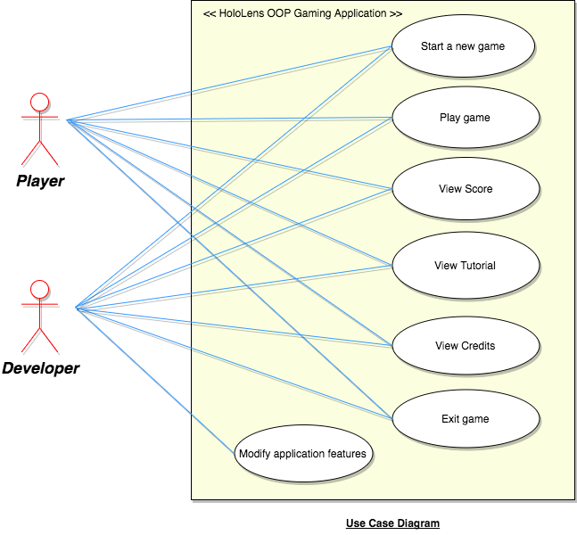
Requirements: Use Cases
Use Case Diagram
Notes:
5 seconds
Show the Use Case Diagram for the whole project. Highlight your use cases.

Slide 6
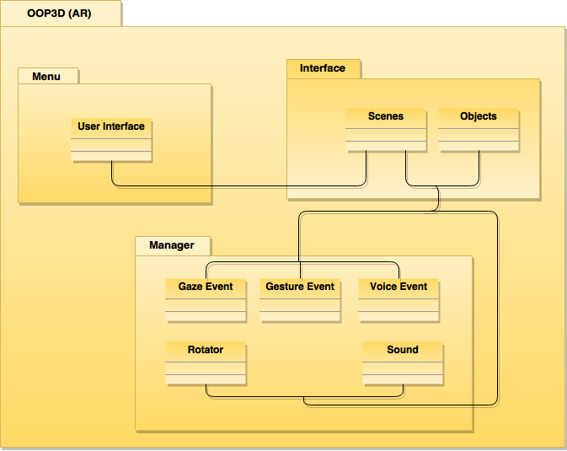
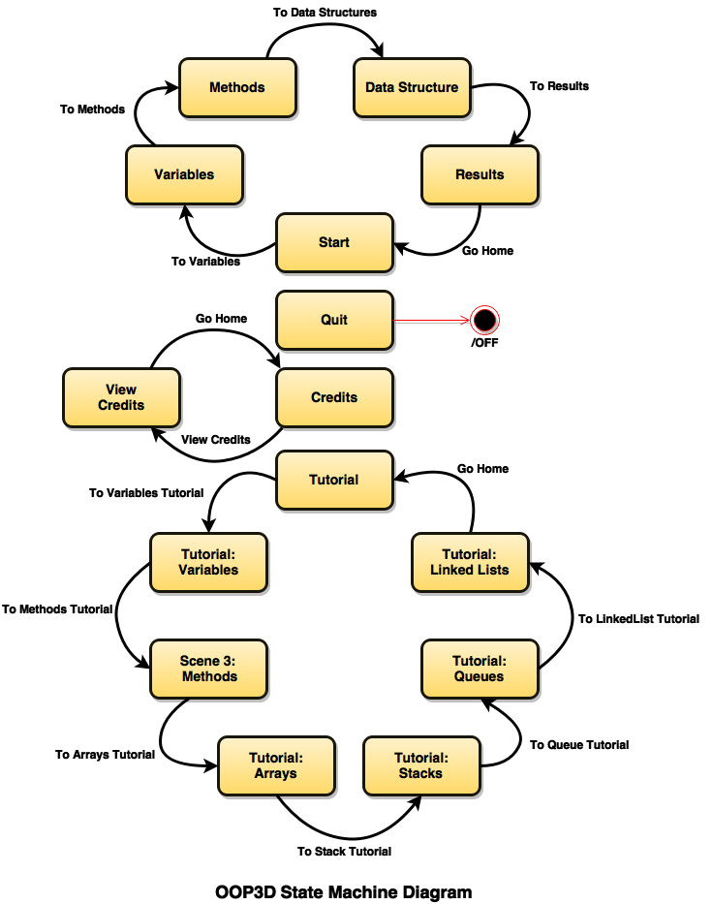
System Design: Architecture
Package Based Approach
Application State Machine
Notes:
20 seconds
System design: Highlight the parts that you contributed to them.
1. System decomposition; identify the architecture patterns used
2. System deployment – h/w and s/w requirements

Slide 7
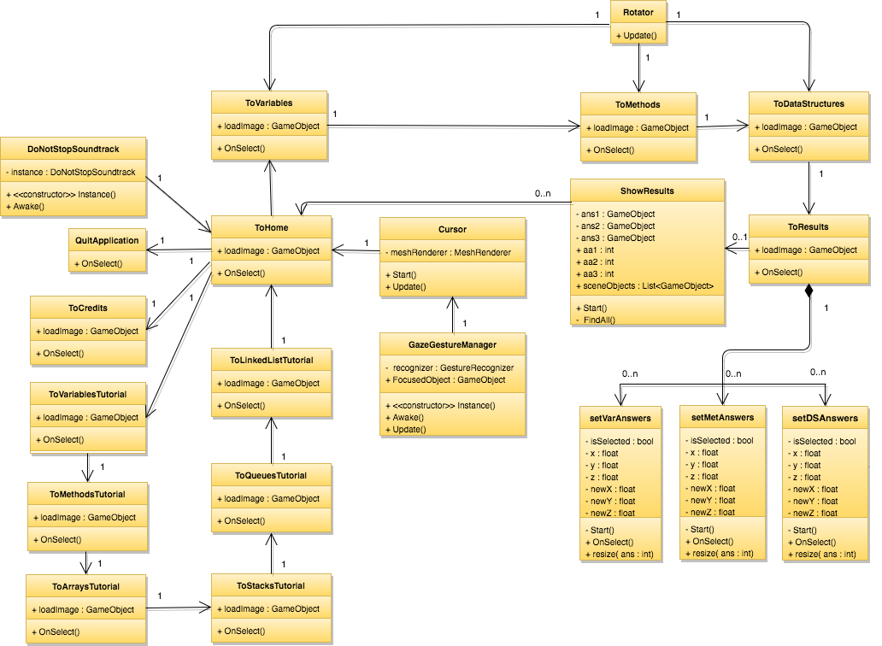
Minimal Class Diagram
Notes:
10 seconds.Minimal class diagram. Highlight the classes that you created/modified
Identify the design patterns used (one or more slides).

Slide 8
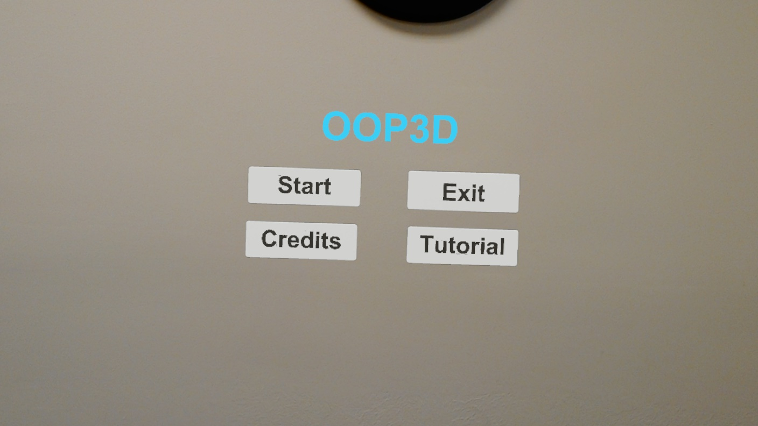
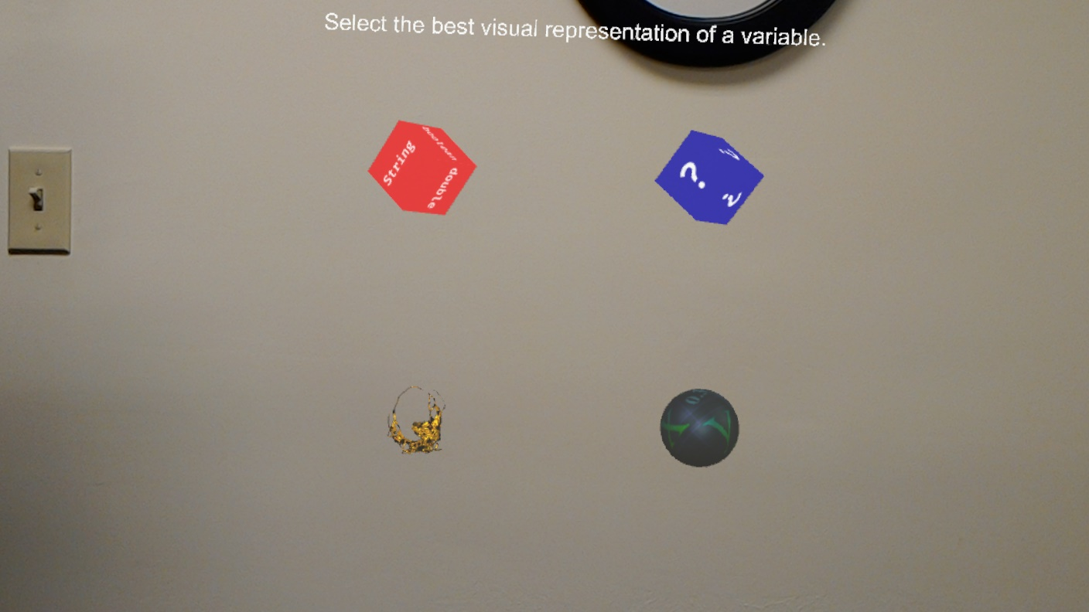
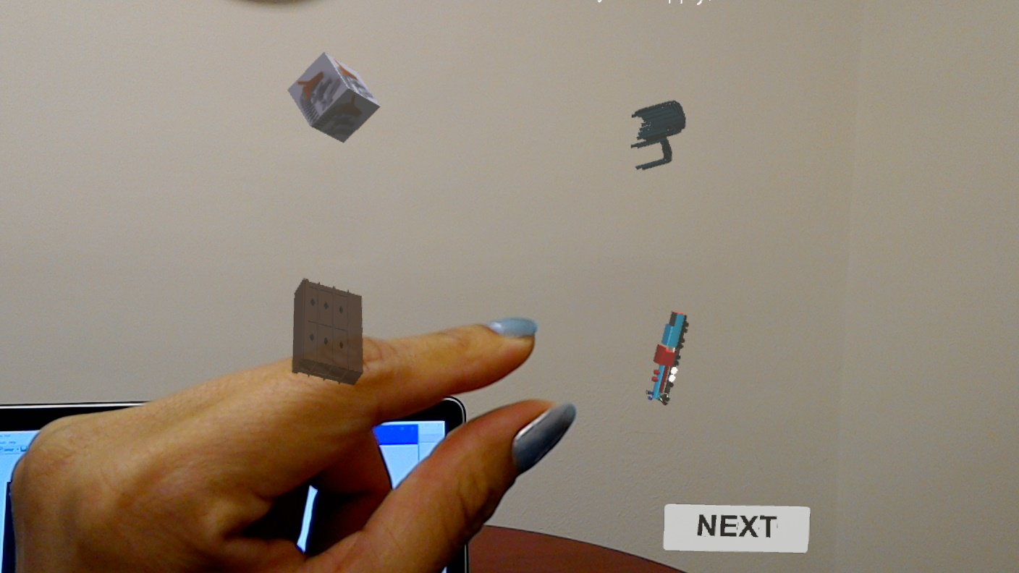
User Stories
1. Object Variables
2. Scenes
3. Methods
4. Data Structures
5. User Feedback and Progress
User Interface Examples
Notes:
5 seconds.
List the user stories that you worked on them.(put in order of importance). Stay focused on the parts that you have been working.

Slide 9
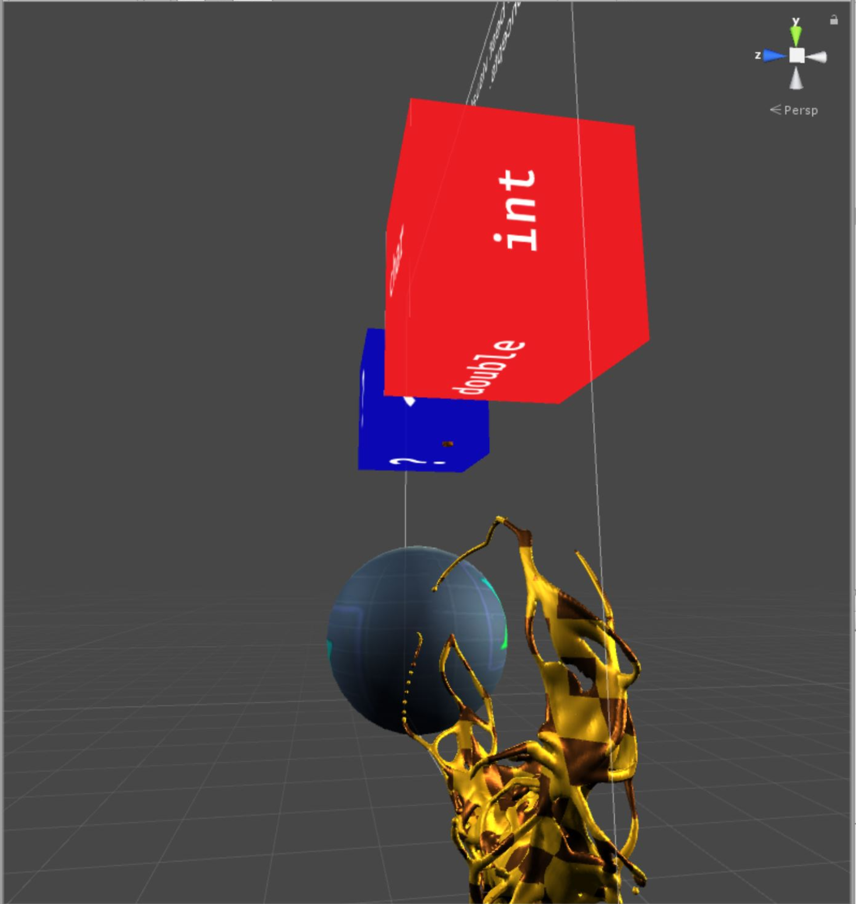
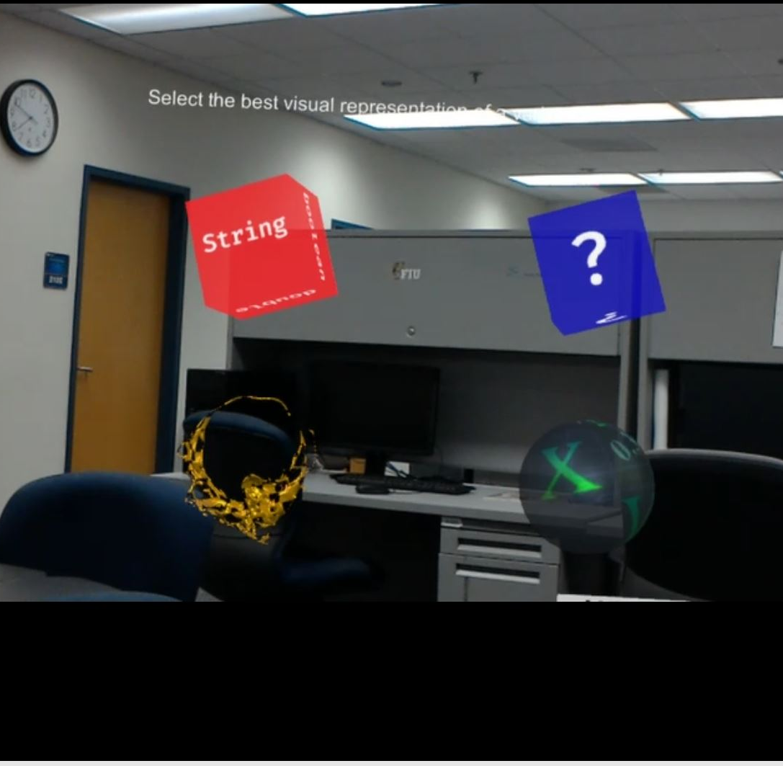
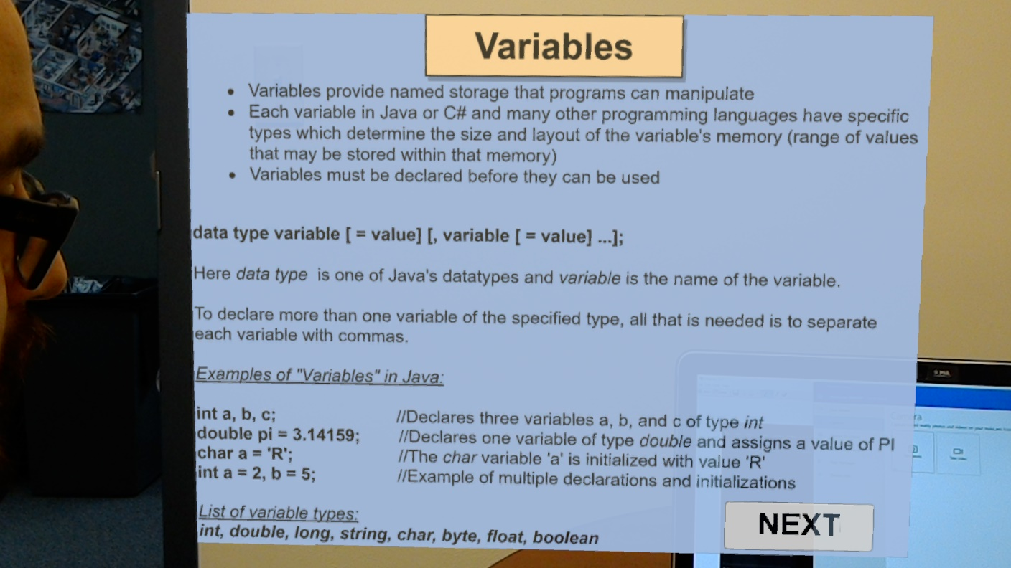
User Story #1: Object Variables
"As a user I want to be able to use gestures and gaze on visual representations of variables so that I know where my gaze is and make a selection on the 3D environment."
Object Variables Scene
Variables Tutorial Scene
Notes:
60 seconds
The tile of user story
The most important user story you worked on it. You have to describe this one very well and be proud of that.
Please present and show the complexity of your work, code, algorithms, and technical challenges and technologies you have used. (you could use screenshot if you want. Visual presentations are better than text presentation)
Go into the details of the most important/significant tasks using bullet lists or visual graphs or state chart diagram
Sequence Diagram for this user story is mandatory (in another separate page if required)
Demo using screenshots or GIF (in another separate page if required)

Slide 10
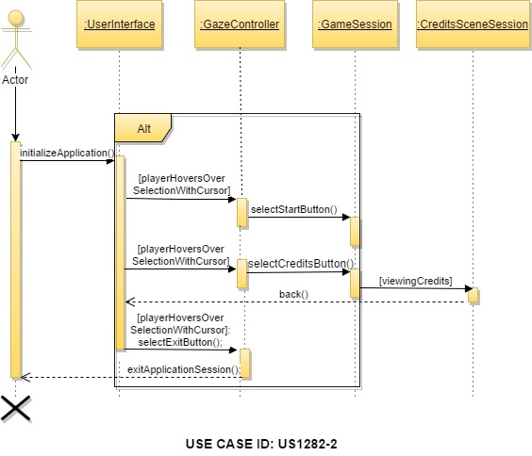
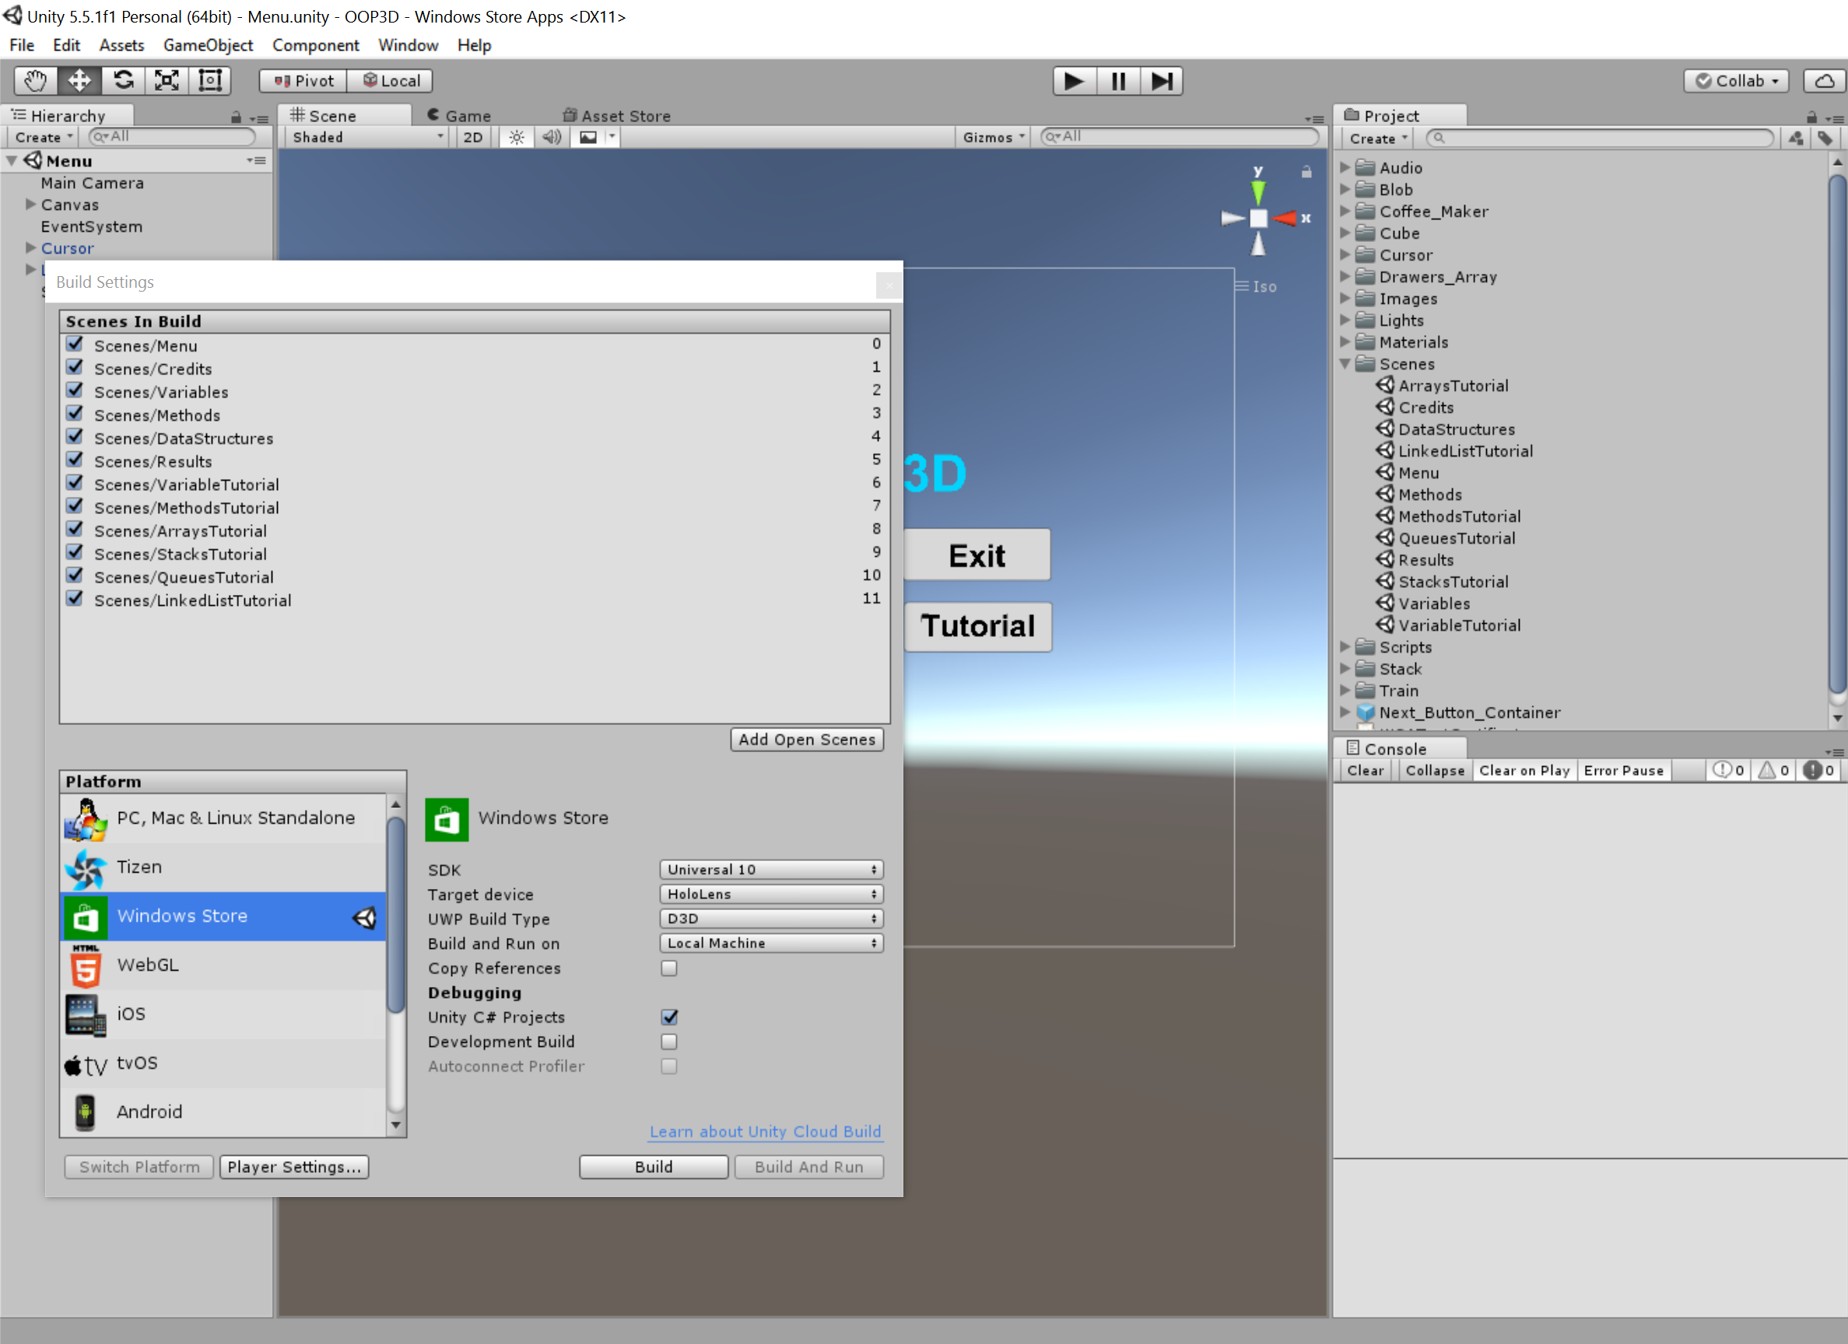
User Story #2: Scenes
"As a user, I would like to move through scenes as I progress through the 3D application so that I can focus on one scene at a time."
Scene Transition Sequence Diagram
Scene Collection
Notes:
20 seconds
The tile of user story
Please present and show the complexity of your work, code, algorithms, and technical challenges and technologies you have used. (you could use screenshot if you want. Visual presentations are better than text presentation) - Go into the details of the most important/significant tasks using bullet lists or visual graphs or state chart diagram - Demo using screenshots or GIF (in another separate page if required)
Sequence Diagram for this user story is optional

Slide 11
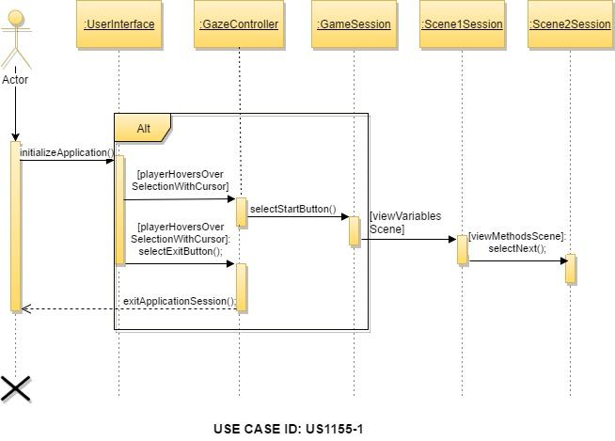
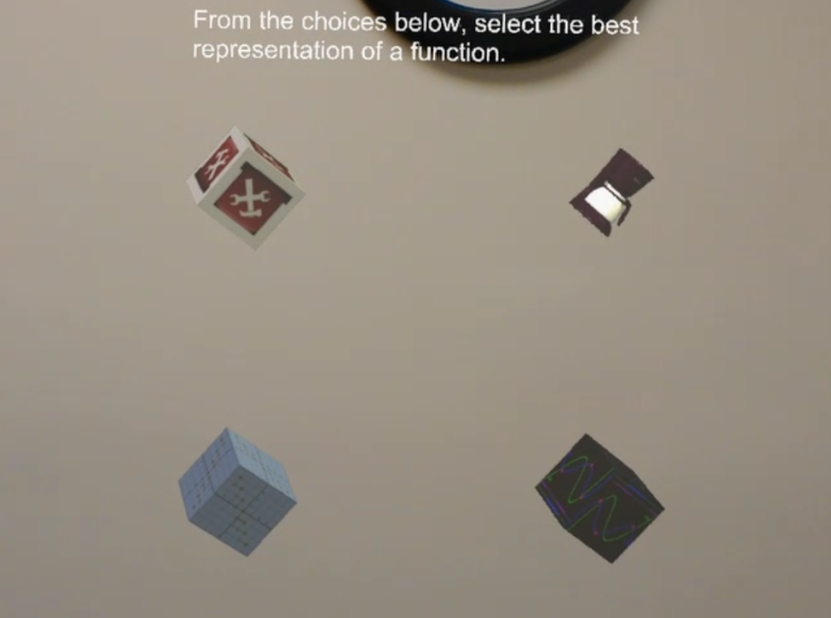
User Story #3: Methods
"As a user I would like to see a visualization of methods and functions so that I can better understand the characteristics of methods."
Methods Sequence Diagram
Methods Scene
Notes:
20 seconds
The tile of user story
Please present and show the complexity of your work, code, algorithms, and technical challenges and technologies you have used. (you could use screenshot if you want. Visual presentations are better than text presentation) - Go into the details of the most important/significant tasks using bullet lists or visual graphs or state chart diagram - Demo using screenshots or GIF (in another separate page if required)
Sequence Diagram for this user story is optional

Slide 12
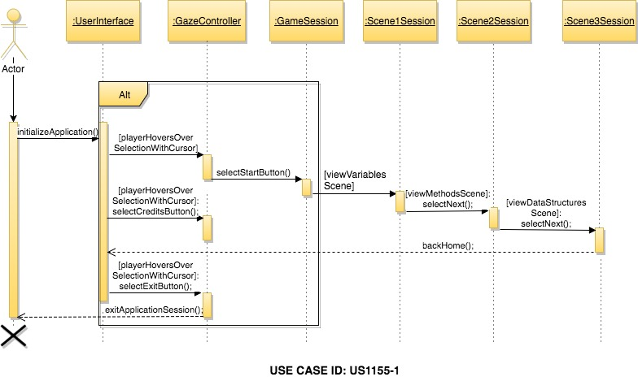
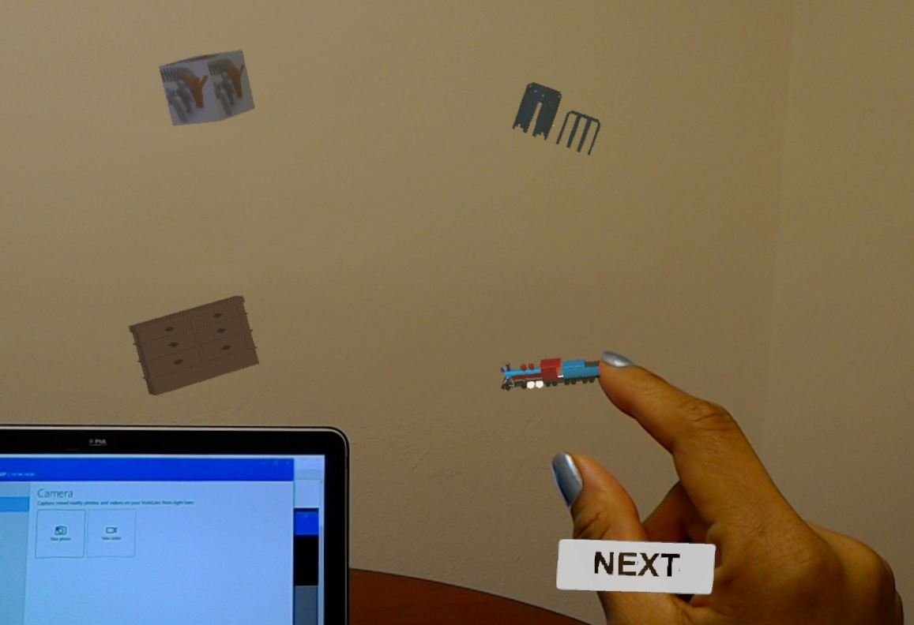
User Story #4: Data Structures
"As a user I want to view visual representations of data structure concepts so that I can better understand data structure concepts."
Data Structures Sequence Diagram
Data Structures Scene
Notes:
20 seconds
The tile of user story
Please present and show the complexity of your work, code, algorithms, and technical challenges and technologies you have used. (you could use screenshot if you want. Visual presentations are better than text presentation) - Go into the details of the most important/significant tasks using bullet lists or visual graphs or state chart diagram - Demo using screenshots or GIF (in another separate page if required)
Sequence Diagram for this user story is optional

Slide 13
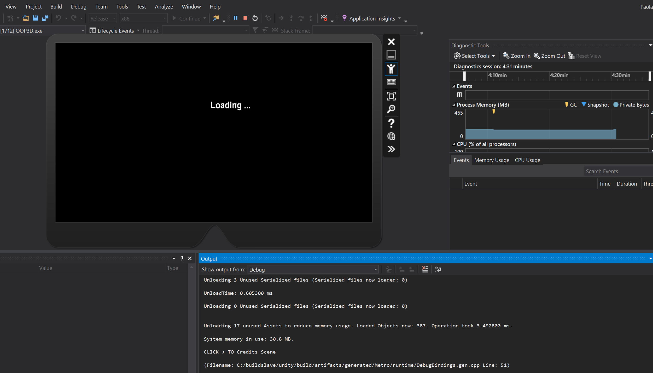
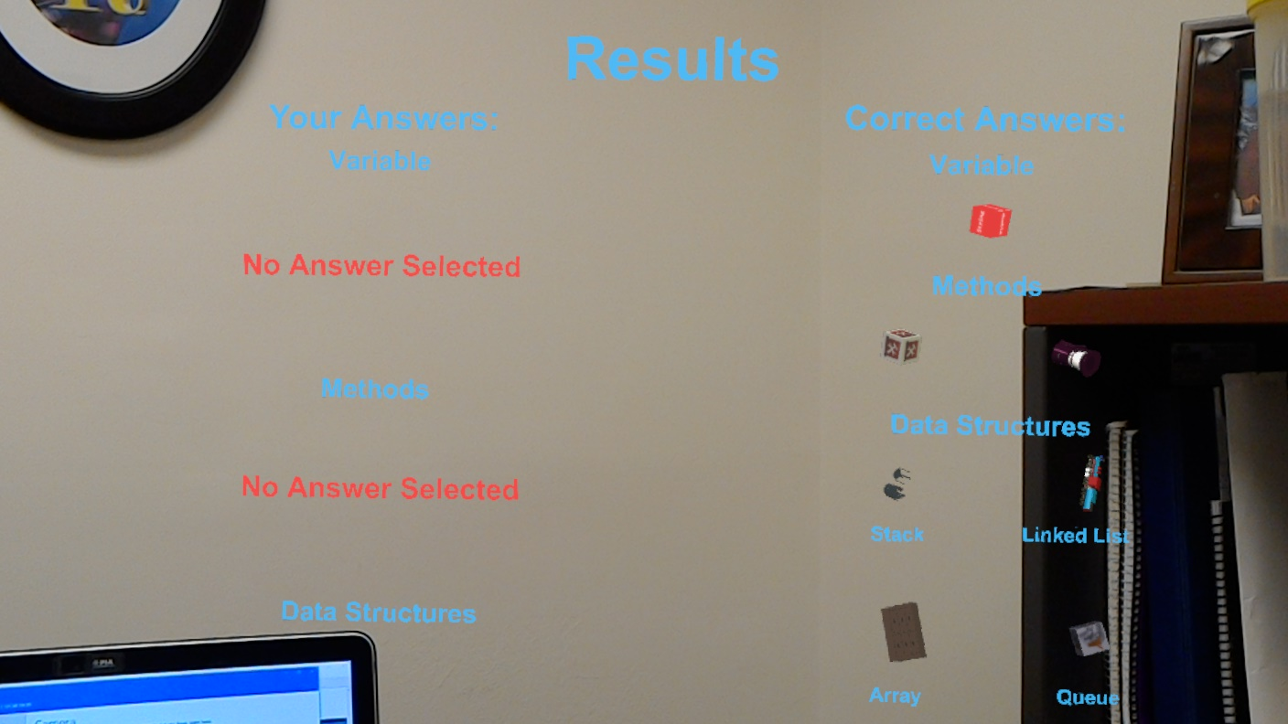
User Story #5: Feedback & Progress
"As a user I want to receive feedback so that I can track my progress in the OOP Concept AR application."
Loading Scenes
Unanswered Questions
Notes:
20 seconds
The tile of user story
Please present and show the complexity of your work, code, algorithms, and technical challenges and technologies you have used. (you could use screenshot if you want. Visual presentations are better than text presentation) - Go into the details of the most important/significant tasks using bullet lists or visual graphs or state chart diagram - Demo using screenshots or GIF (in another separate page if required)
Sequence Diagram for this user story is optional

Slide 14
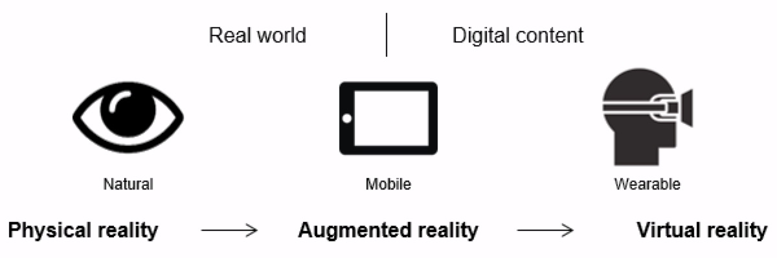
Research
Educational Benefits
Learning with Augmented and Virtual Reality
Rising impact of Augmented and Virtual Reality in Academia

Slide 15
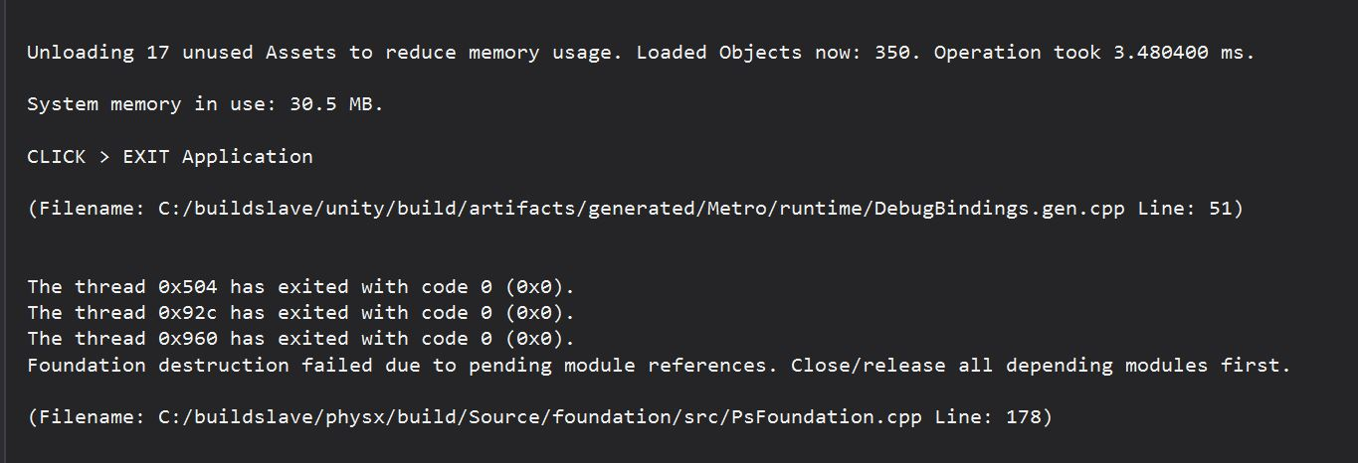
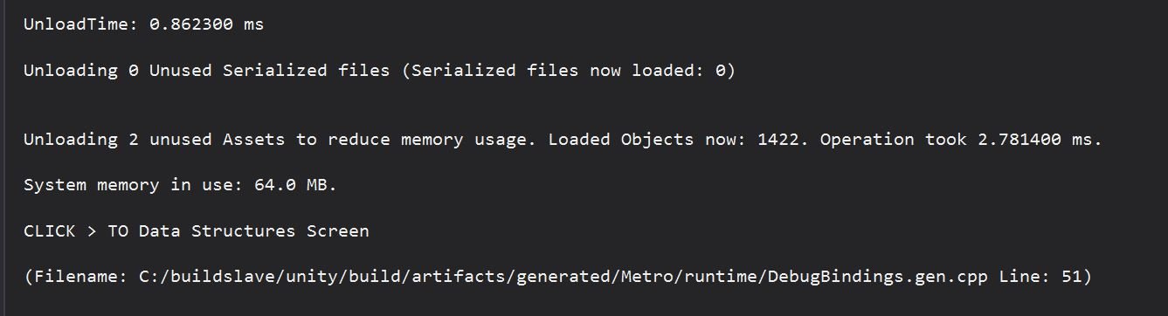
Testing
Manually testing transition
Start
Next
Credits
Tutorial
Home and,
Quit
buttons
Quit Application
Scene Transition
Notes:
10 seconds
A description of verification process and Test Suites and Test Cases for one of the use cases.
1 One sunny day and one rainy day for the implemented use cases (one or more slides).
2 Automated test scripts for the implemented use cases (if any) (one or more slides).

Slide 16

Introduction
Traditional Education
Face-to-Face interaction
Scholarly papers, journals, and textbooks focused
Modern Education
Slow grasp of new ideas
Research shows an improvement
Student engagement
+ Understanding content
= Academic Improvement

Slide 17
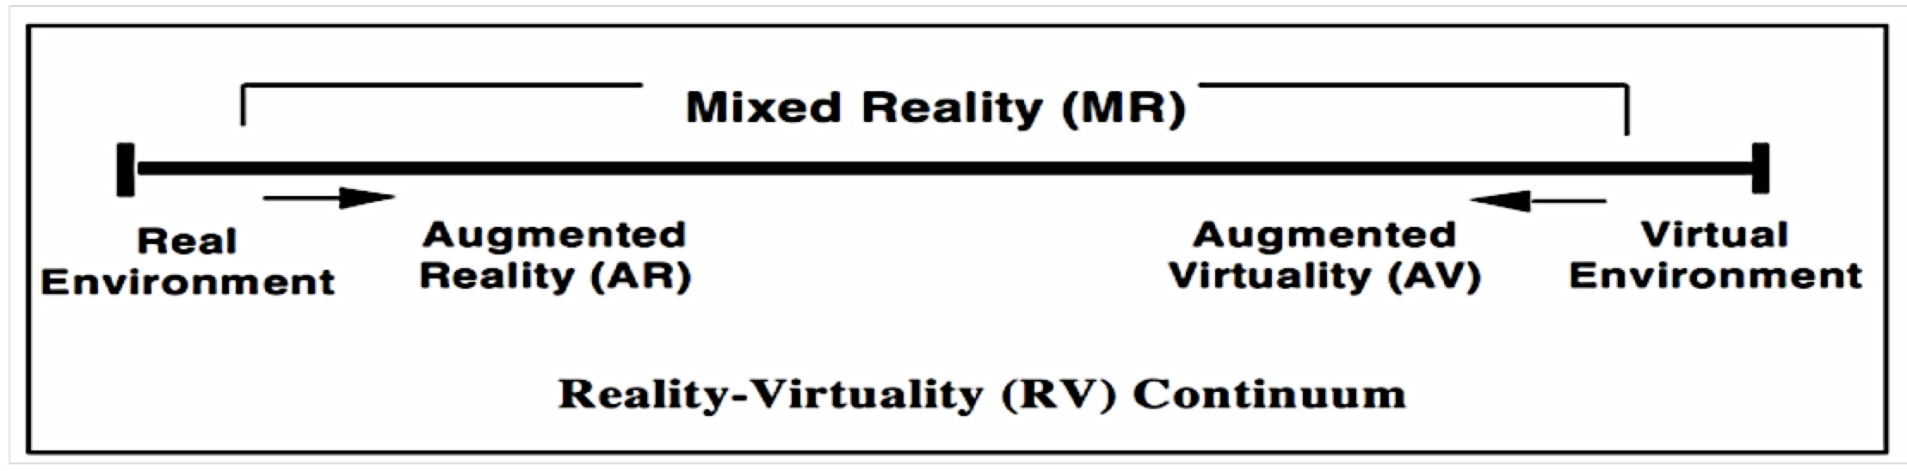
Augmented and Virtual Concept
Benefits
Layman person does not understand meaning and practicality in applying technology
Reality-Virtuality Continuum
Clarity in distinction between Virtual and Augmented Reality

Slide 18
AR/VR Educational Benefits
The Five Directions
Learning
Teaching
Improve learning outcome
Understanding
Retaining information
Teaching and Learning Results
Better grades
Better grasp in course material
Better delivery of course material
Better academic performance

Slide 19

Learning by Discovery
Creates a link between practice and education
Augmented and Virtual Reality introduce students to:
Dynamic real world scenarios
Real world situations
VR Field trips and Field work
Virtual and Augmented Reality enables students to:
Visualize concepts in 3D
Encourage teamwork and ease the learning experience of various fields

Slide 20
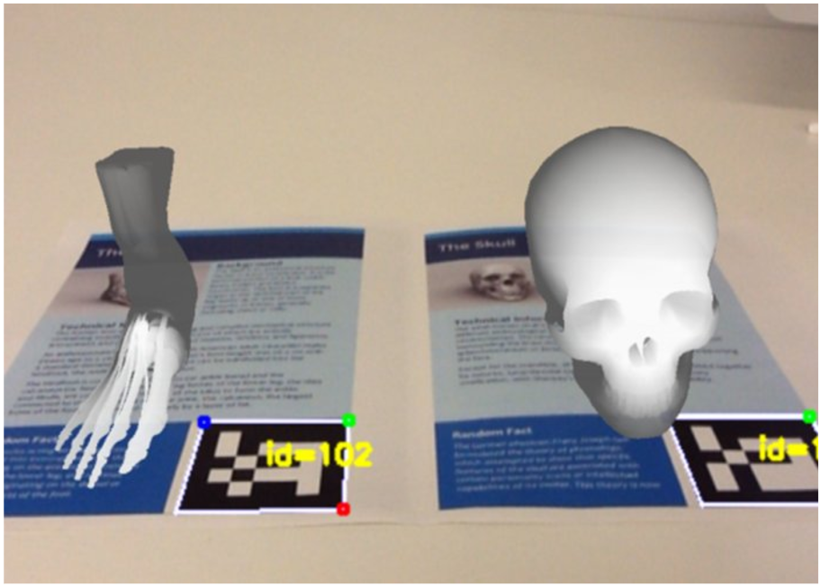
Object Modeling
Allows quick visual feedback
Virtual objects can be investigated through:
Physical characteristics
Other element interaction
Creates an interesting learning environment
Combination of experimental and life-like properties
Student approved
Engage in higher education

Slide 21
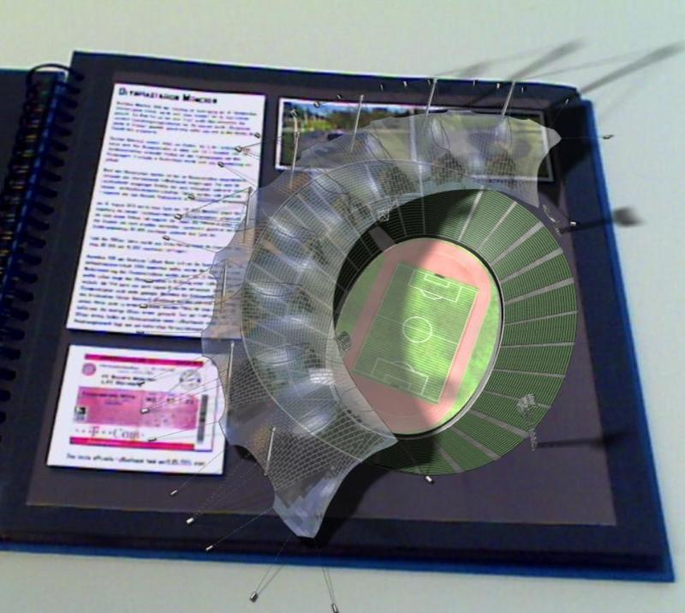
Augmented Reality Enhanced Books
They are multimedia and voice enhanced physical books
Provide
3D presentations
Interactive learning
Improved understanding
Facilitate collaborative learning
Improved student learning mood
Potentially leading to higher grades

Slide 22
Skill Training
Display
Steps
Tools identification
Text instructions
Using head mounted displays
Easy troubleshooting
Real task and training connections
Reinforces knowledge retention
Monitoring and evaluation
Student performance
Student progress
Tutoring aide and feedback
Real-time responses

Slide 23
AR/VR Gaming
Ensures
Effective delivery and Comprehension of content
Offers
High visualization
Interactive learning
Training simulation
Allows
Virtual integration over a real environment
Games deliver important messages
Valuable in student based sensitivity
Challenges students
Engage in problem solving situations

Slide 24





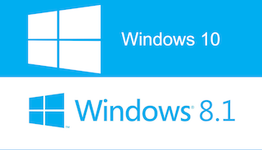







Summary
Paola Jiron
pjiro003@fiu.edu
Andres Chalela
achal012@fiu.edu
Thank You!
Notes:
10 seconds
Summarize your contribution, mention your effort for Scrum, Mingle, Github, Google Drive Documentation and minutes
Include your contact information
Ask if anyone has any questions for you.
Thank your audience

